Slide 1

CEC Charger Reliability Study Economics
Aaron Rabinowitz
3/12/2024

Slide 2
Routing Methodology
Overview
Goal is to minimize the cost of the project by computing optimal routes which minimize for time
Less time is less student pay
Less time is less car rental expense
Less time is less operational expenditure
Routing is accomplished by solving Non-Homogenous Fleet Capacitated Vehicle Routing Problem (NHFCVRP)
Chargers are destinations to be visited
EVRC + overnight stay locations are depots
Fleet size is reflected in vehicle days (each itinerary is treated as an independent vehicle)
SNHFCVRP is solved using Stochastic Clarke-Wright savings method and solution is refined via Simulated Annealing
In line with current operations planning
Routes can be generated for a level of risk - this has material effects on the project outcome

Slide 3
Routing Methodology
Constraints
There are three types of route - short, regular, and long to accomodate student schedules as possible
Short routes:
Distance is less than vehicle range
Time is less than 4 hours (testing included)
Must visit at least two stations*
Single Dayroutes
Distance is less than vehicle range
Time is less than 8 hours (testing included)
Must visit at least two stations*
Multi Day routes
Time is less than 24 hours (testing included)
Chargers in close proximity to depots neglected unless unreached
For all routes, in order to enable testing, no leg can be less than 20 km
Traffic condition (and thus link speed) is modeled with a multimodal distribution for conjested and free flow
*Single station routes are possible for short and medium routes but should be avoided as they are very inefficient and, instead, be included in longer routes if possible

Slide 4
Routing Methodology
Testing time
The basic assumption is that a given plug-in test takes a given amount of time
Test times are assumed to be triangularly distrbuted as:
4 minutes, 8 minutes, 12 minutes
For a full slate of 4 DC and 2 AC chargers that would be 24, 48, or 72 minutes at one station
The testers may also have to wait in a queue to use a charger
Expected queue wait time is modeled using M/M/c with exponential distributions
Expected arrival frequency is sampled randomly from separate distributions for urban and rural chargers
10 minutes to 1 hour for urban
30 minutes to 10 hours for rural
Expected service time per vehicle is determined by charging rate
Normally distributed: mean 37.8 kWh, st.d.14.8 kWh
The number of servers is modeled as the listed number of chargers - can have a huge effect
Note that, at this stage all are assumed to be functional - could be adjusted
In general, this model may be adjusted as more information comes in, it is likely an underestimate because of the functionality assumption

Slide 5
Routing Methodology
Operational Concept
The following process will be carried out iteratively until the project is complete
Optimal routes are computed for remaining chargers at midnight (takes about 1 minute)
Students check out a route based on vehicle and time allowance
Students go out and test (will not always follow route)
Students mark off visited stations
It is not possible to know, a priori how students will allocate their time, half-day routes can be scheduled easier but, eventually, will no longer be possible as the close-by chargers are exhausted.
The assumption is that selection of route duration is ordered - short reoute are exhausted, then medium, then long.

Slide 6
Routing Economics
Cost Structure
Car Rentals (Vehicular):
$79,839 over 3 years
$26,613 per year
$19,960 per car
$6,635 per car-year
Salaries (Personnel):
$20 per tester-hour
Hotels (Personnel):
$120 - $275 per tester-night (assume $200)
Per-Diems (Personnel):
$79 per tester-day
Energy Cost (Operational):
$0.50 - $0.72 per kWh
Vehicular
Rent (non-Tesla)
Depreciation (Tesla)
Personnel
Salaries
Hotel + Per Diem
Operational
Energy Costs
All costs expected to rise in years 2 and 3

Slide 7
Routing Economics
Hourly Costs
Max Route Duration | Personnel Costs per Work Hour Davis Depot | Personnel Costs per Work Hour Riverside Depot* | Personnel Costs per Work Hour Humboldt Depot*
4 Hour | 40 | 139.75 | 133.08
8 Hour | 40 | 89.88 | 86.54
16 Hour | 84.75 | 99.75 | 96.42
24 Hour | 84.75 | 99.75 | 96.42
* Includes costs of driving to and from non-Davis depots
Note: inclusion of non-Davis depots substantially reduces total work hours

Slide 8
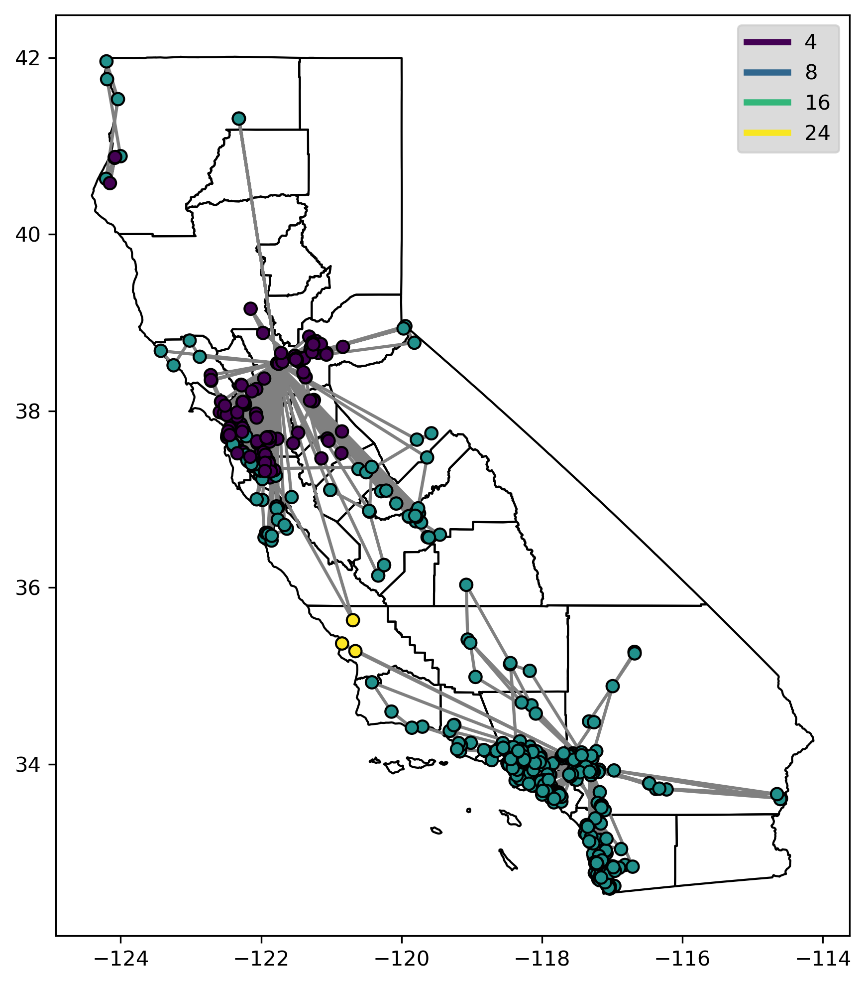
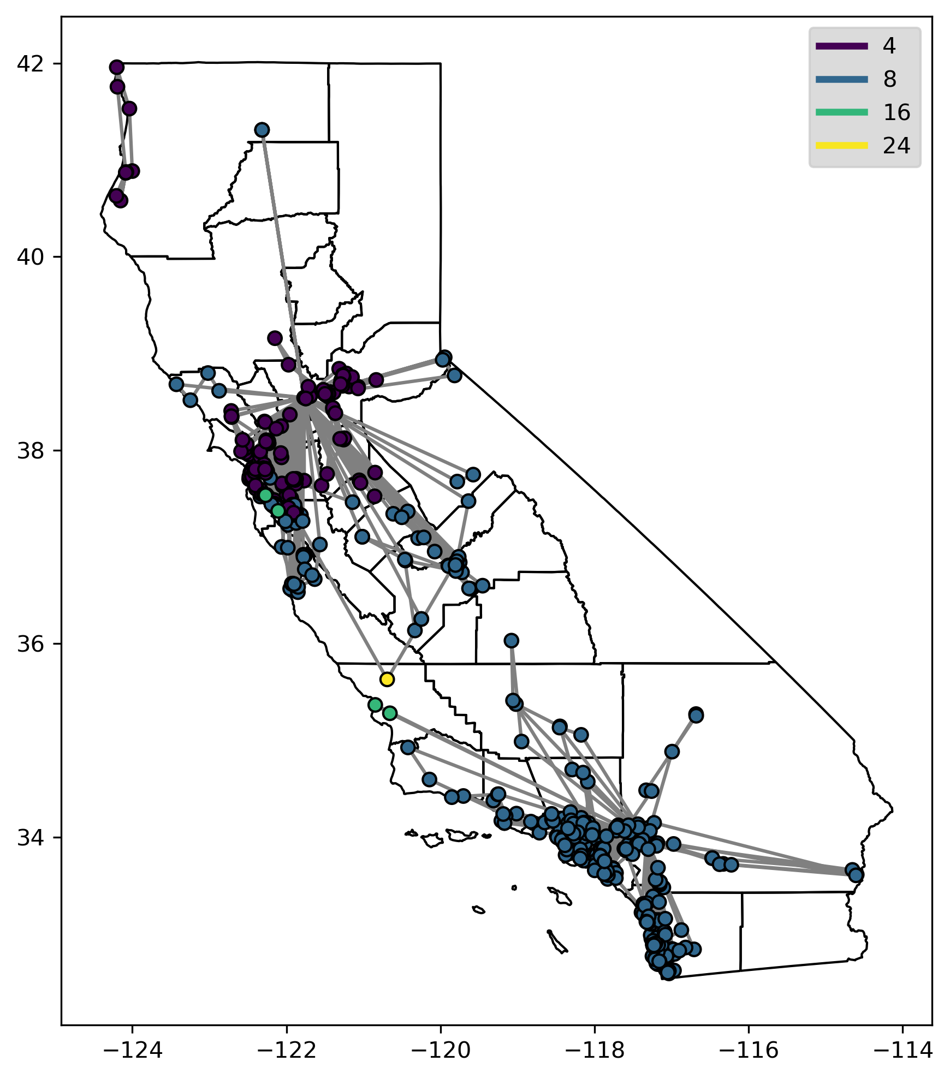
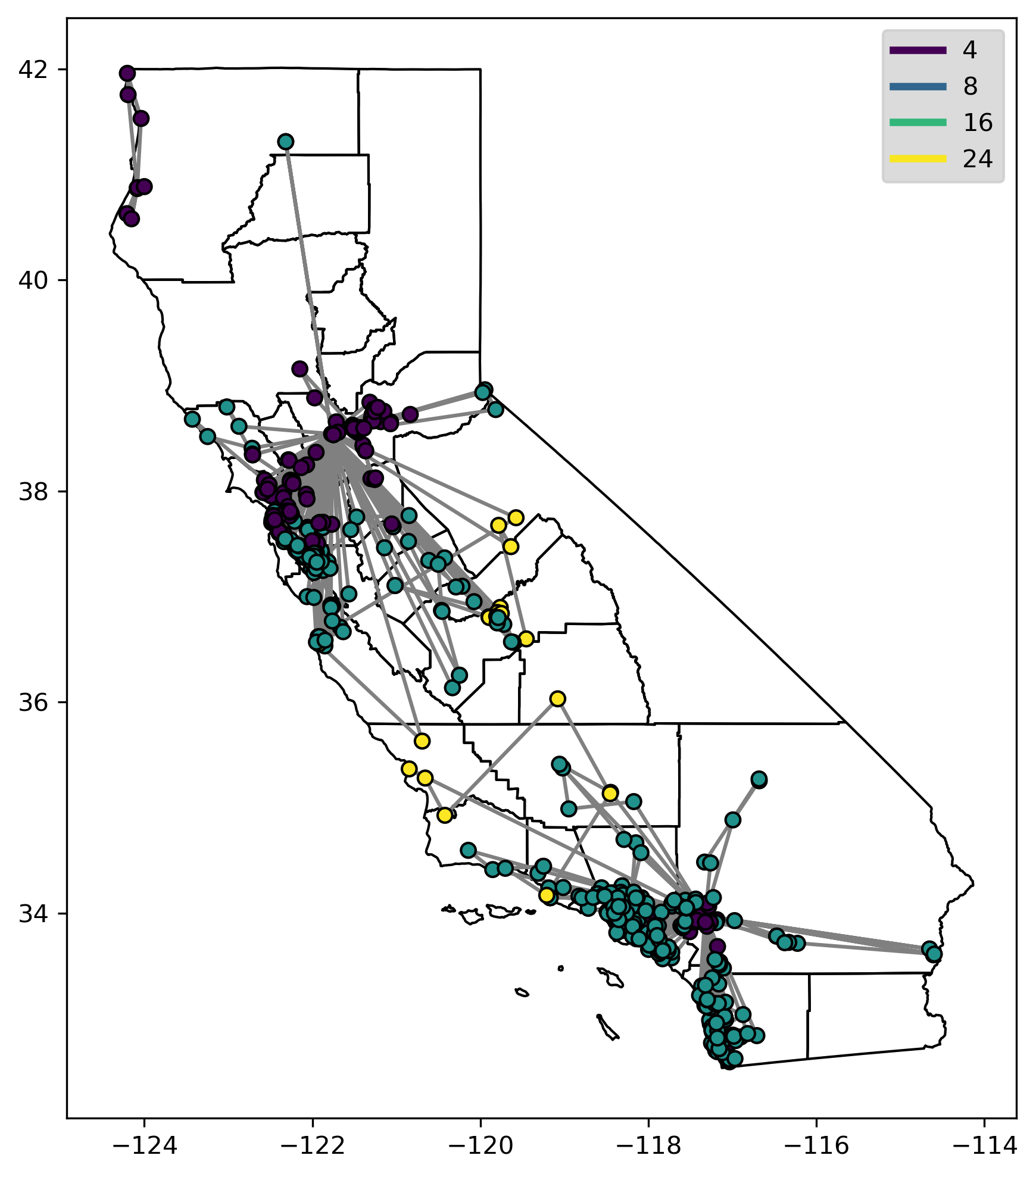
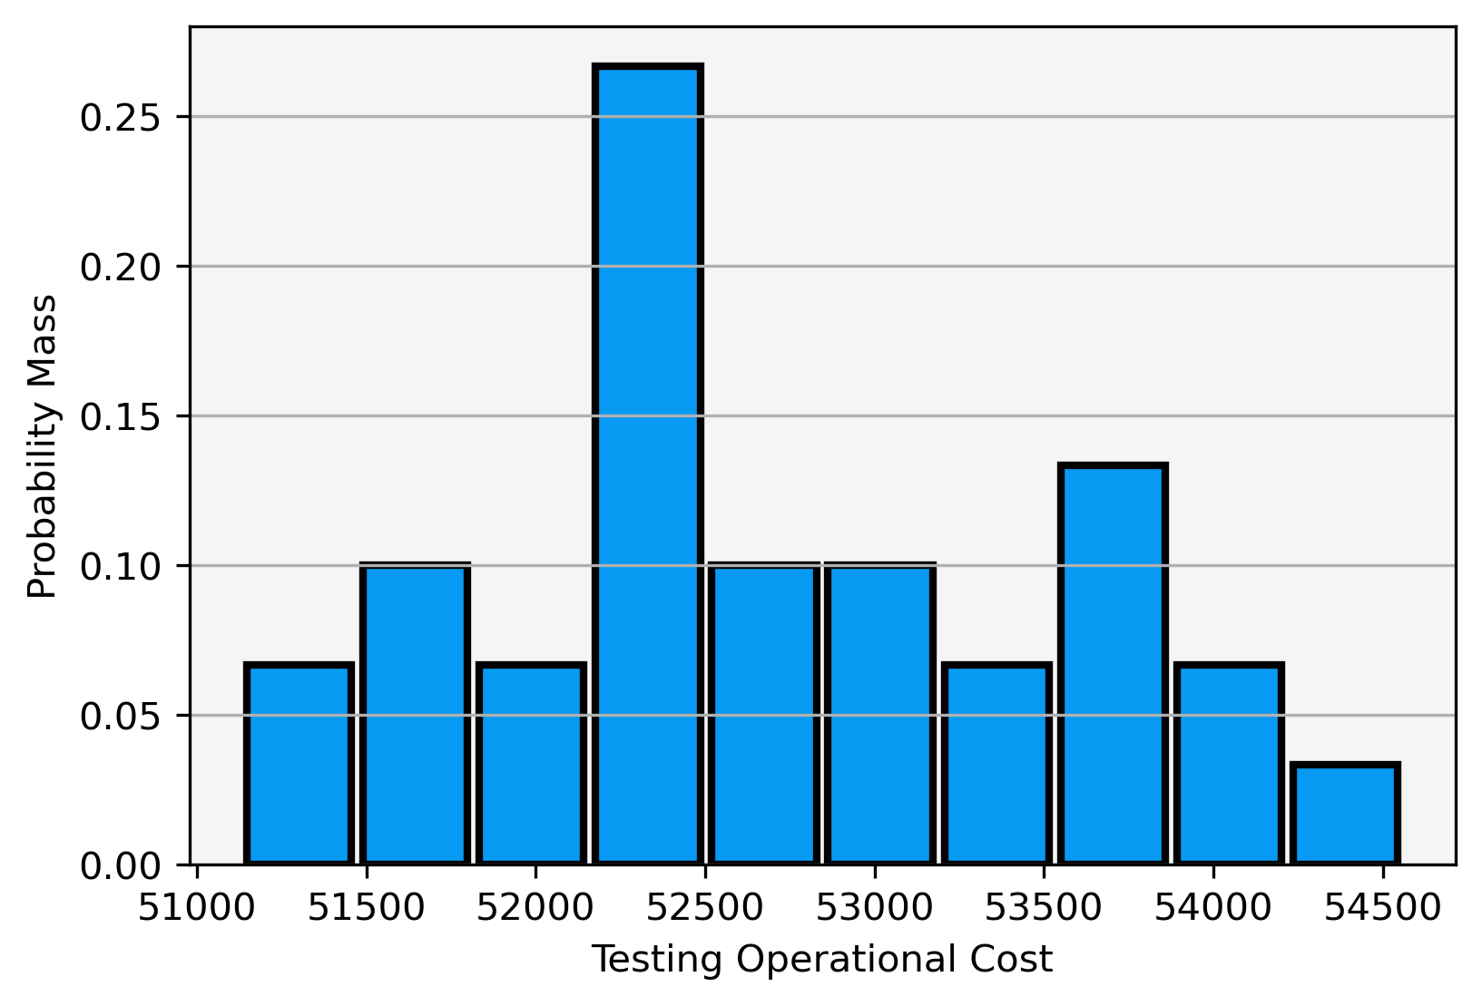
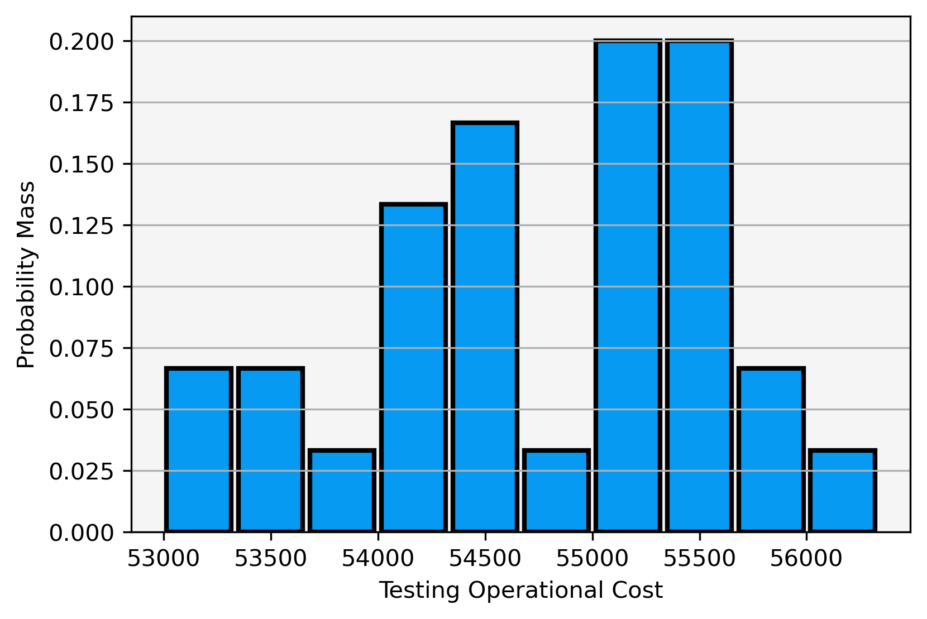
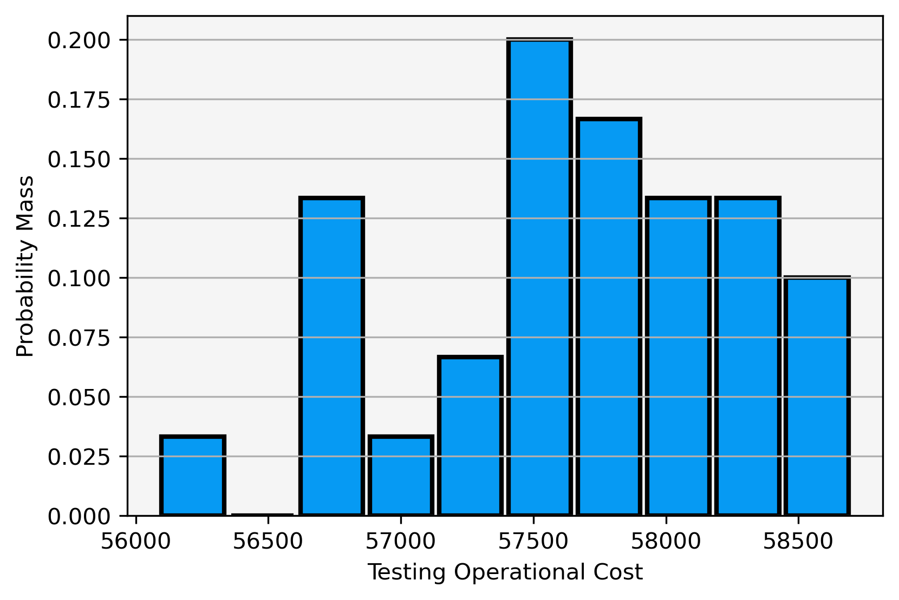
Routing Economics
Bolt Testing - Personnel and Operations
50th Percentile Routing
75th Percentile Routing
99th Percentile Routing

Slide 9
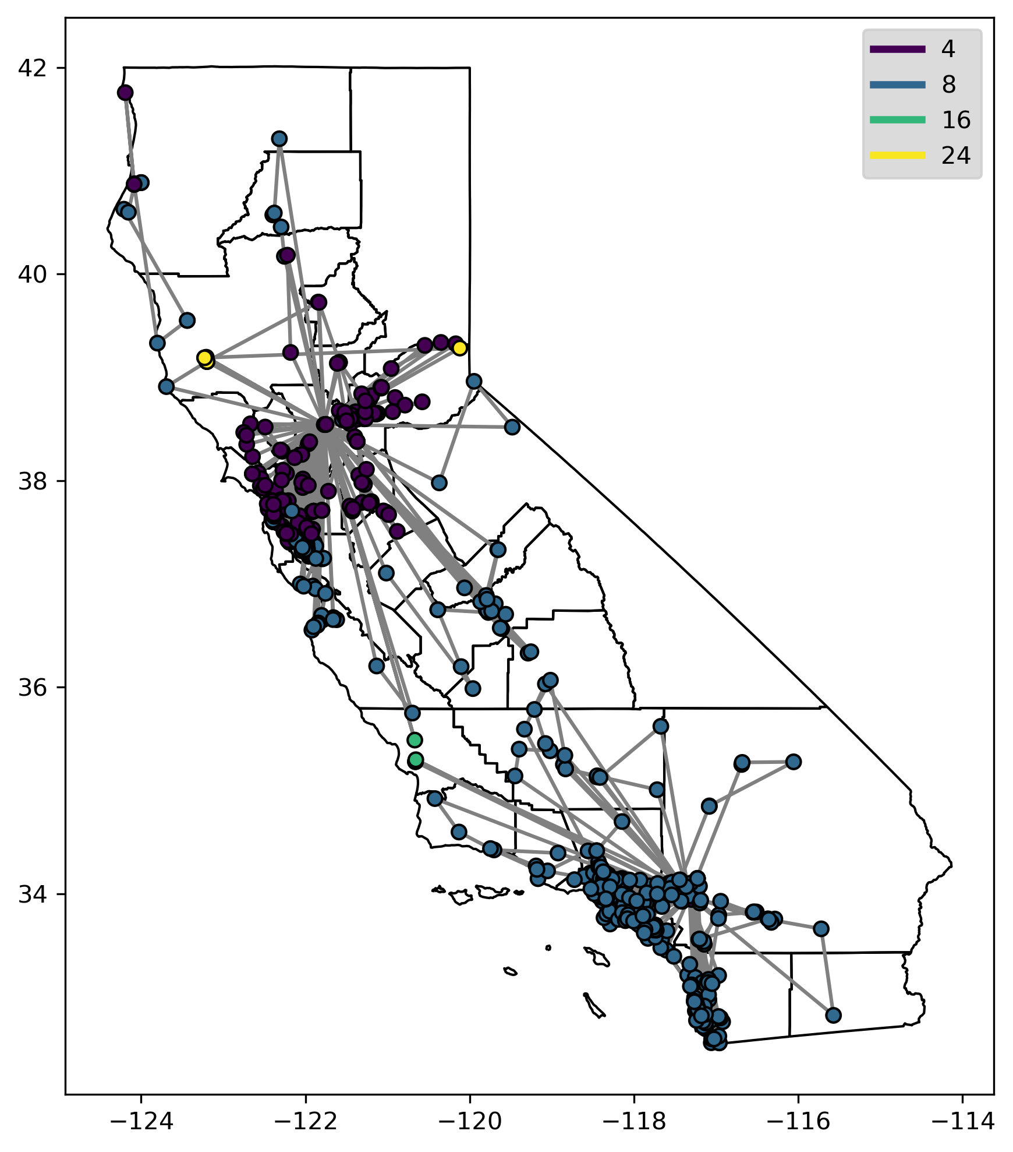
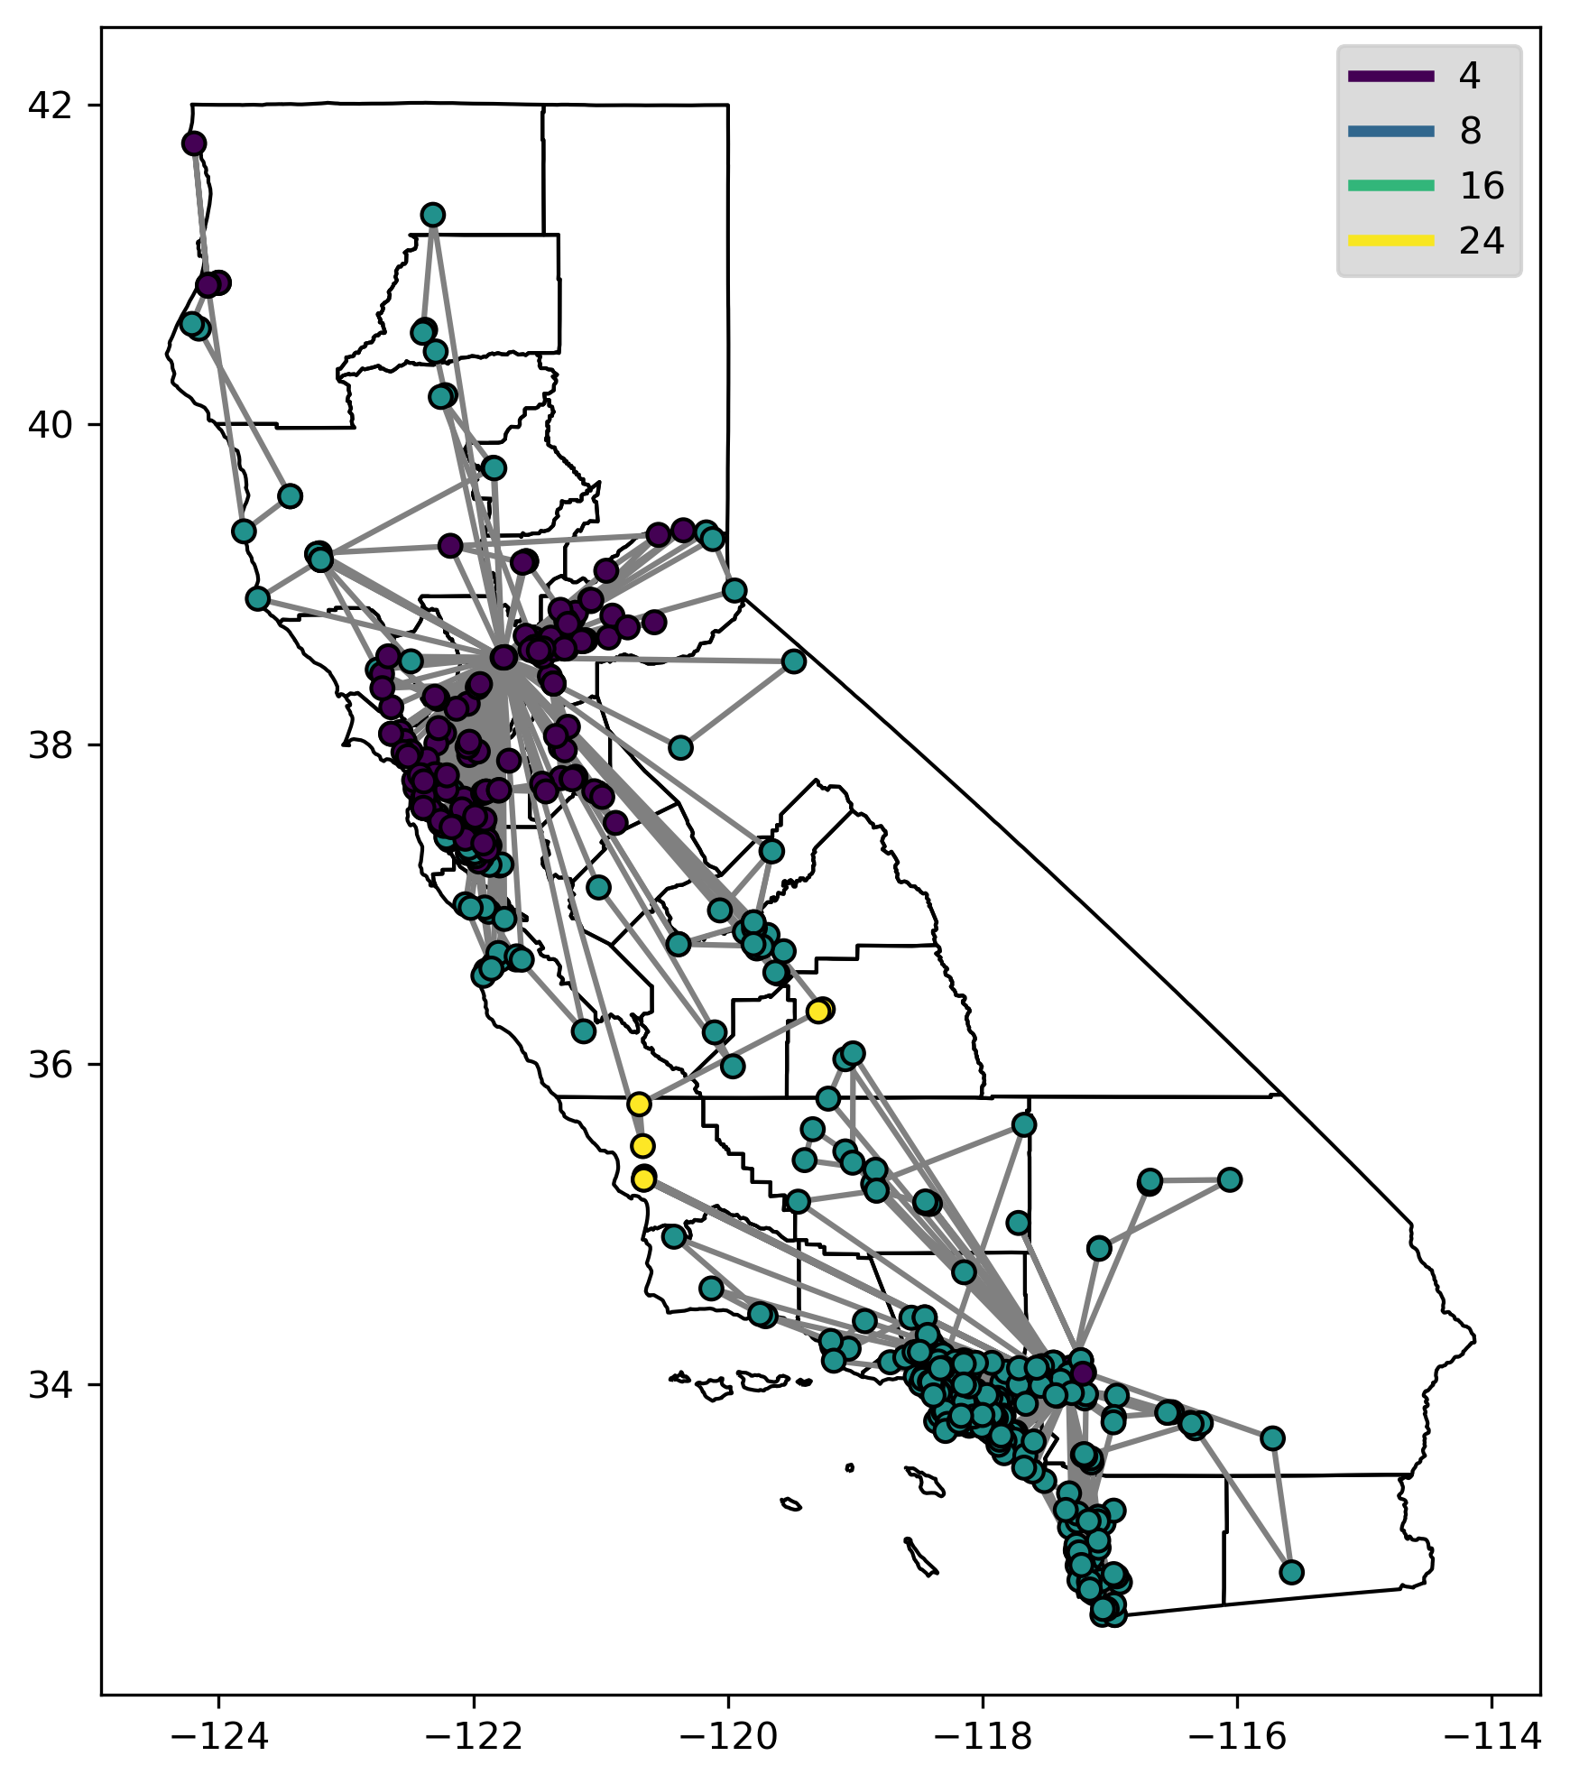
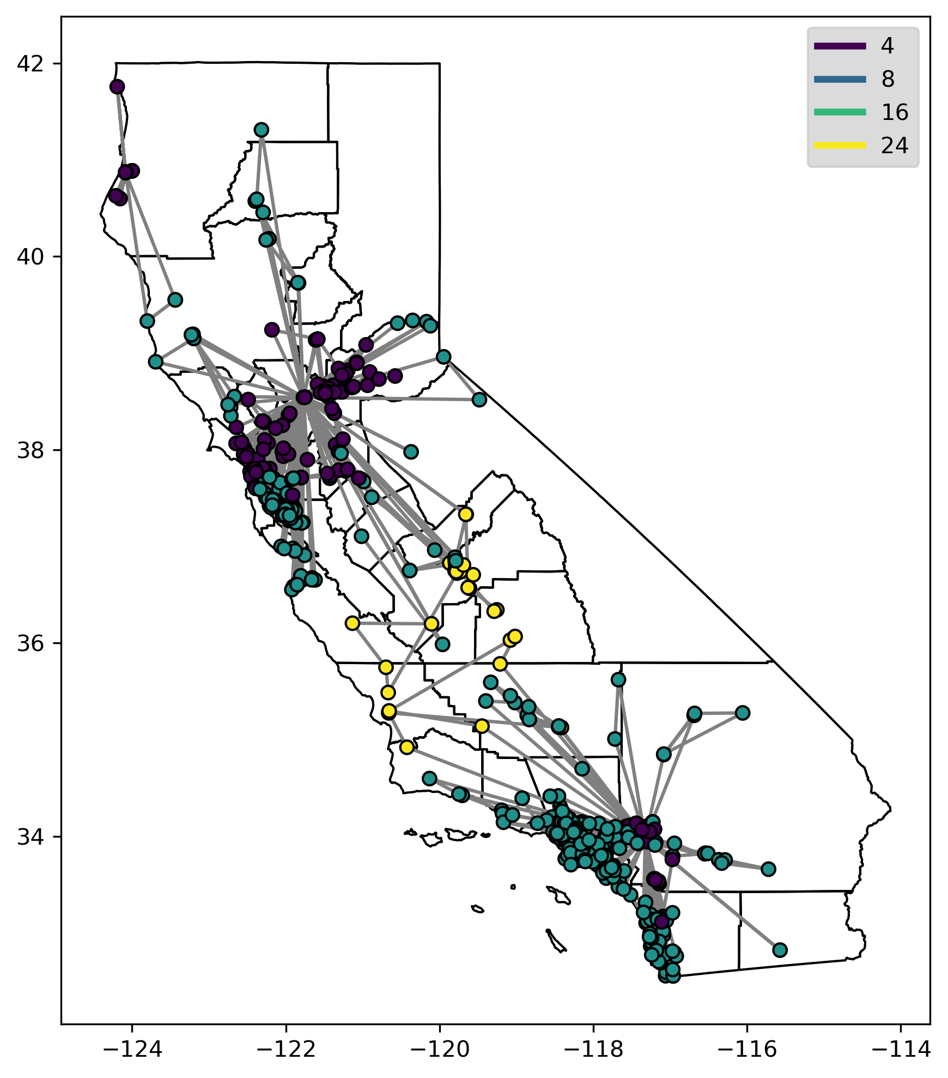
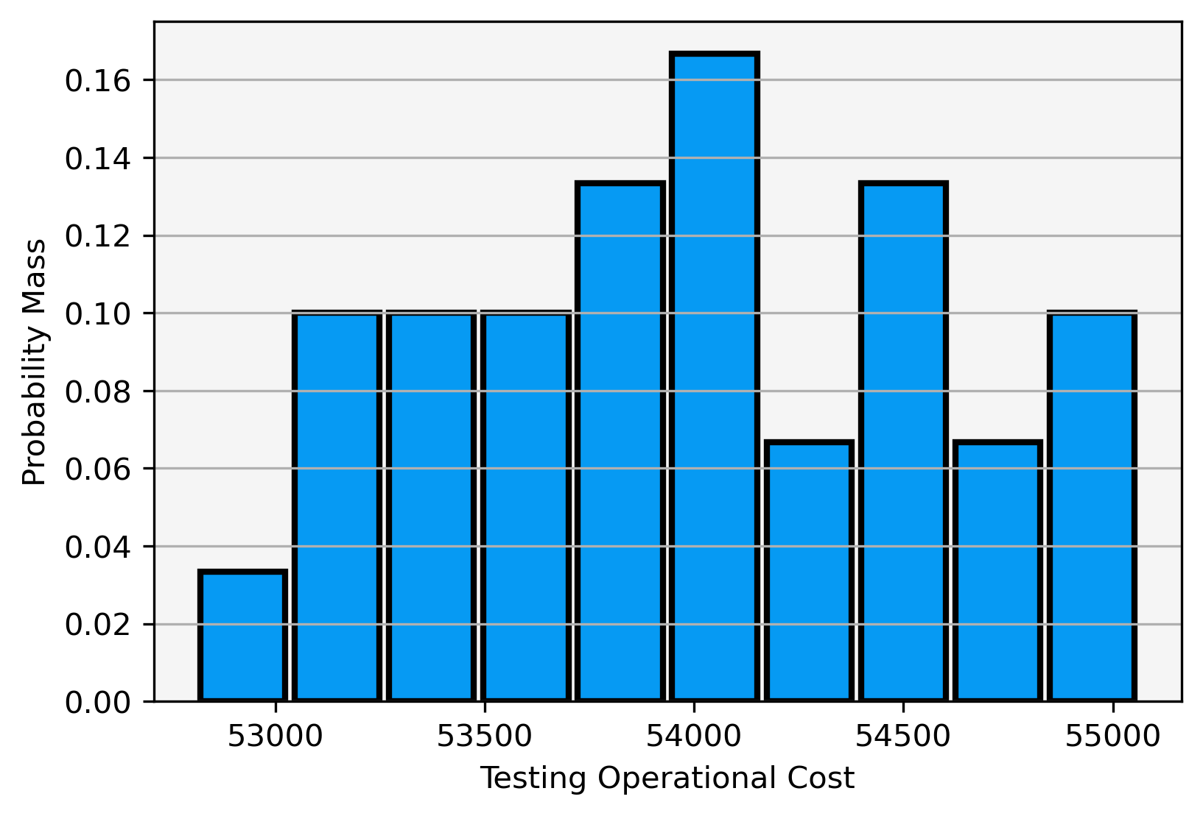
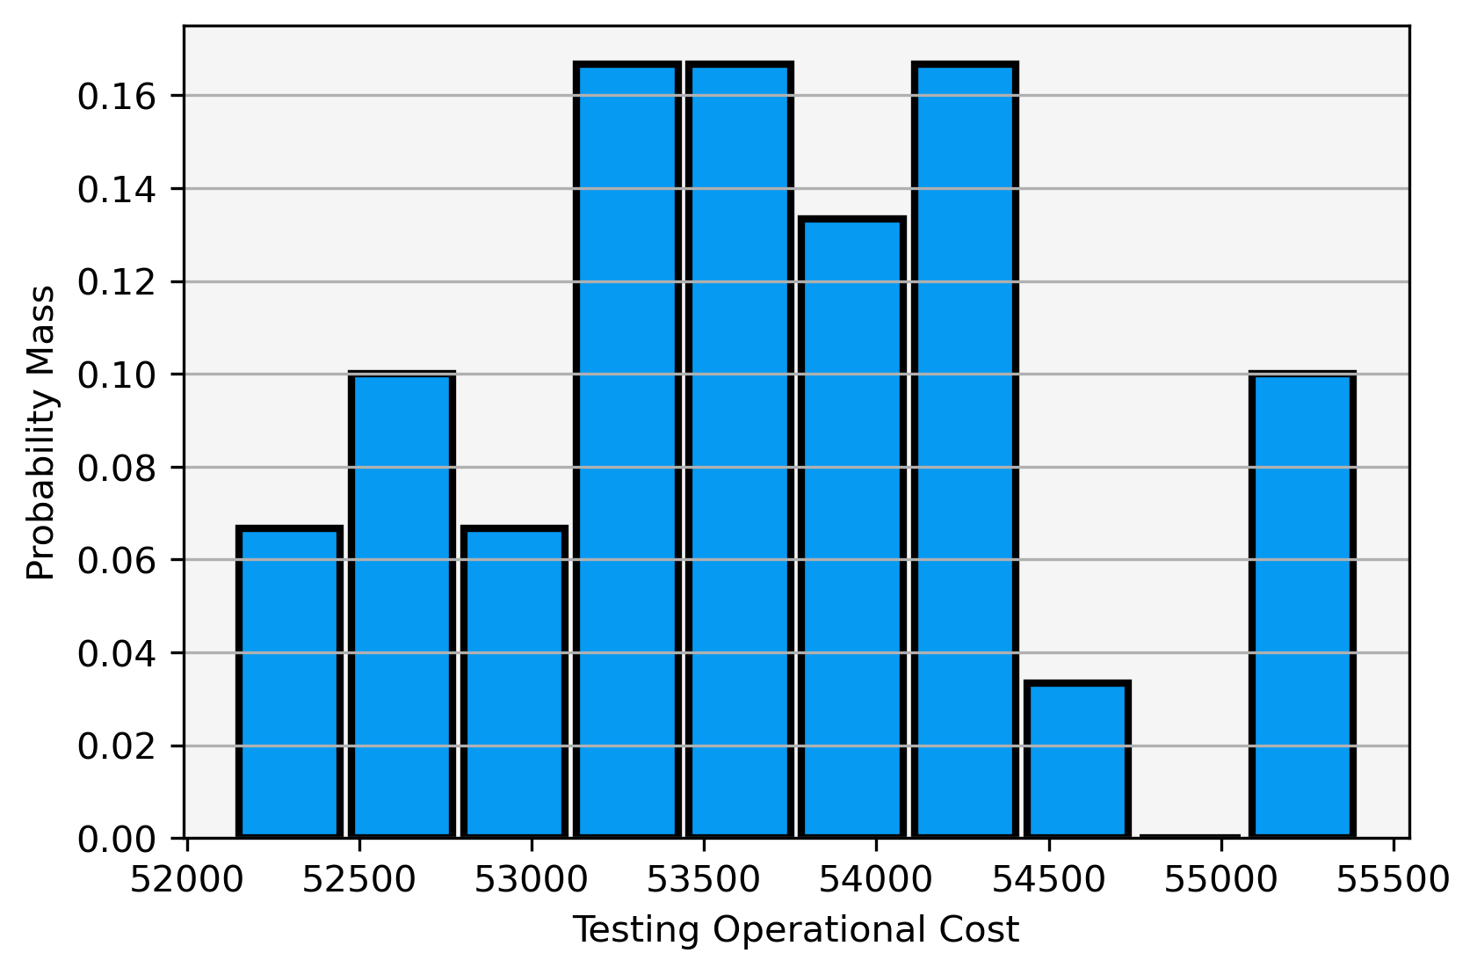
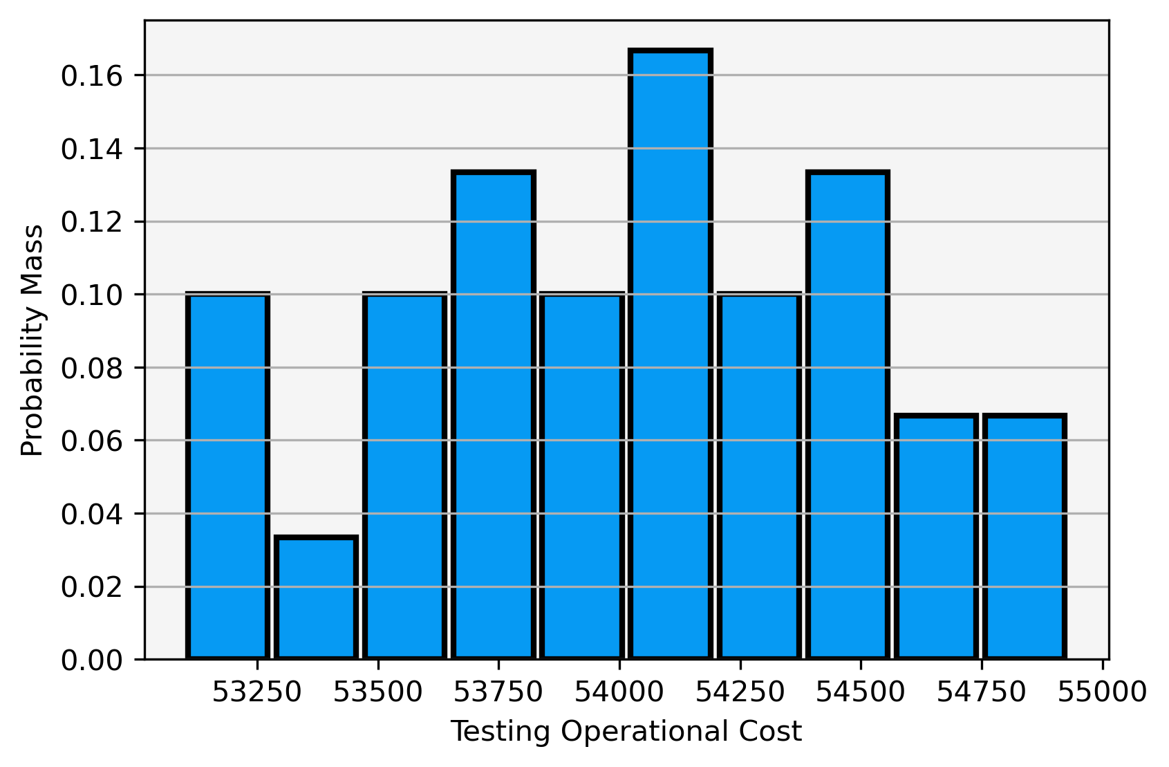
Routing Economics
Lightning Testing - Personnel and Operations
50th Percentile Routing
75th Percentile Routing
99th Percentile Routing

Slide 10
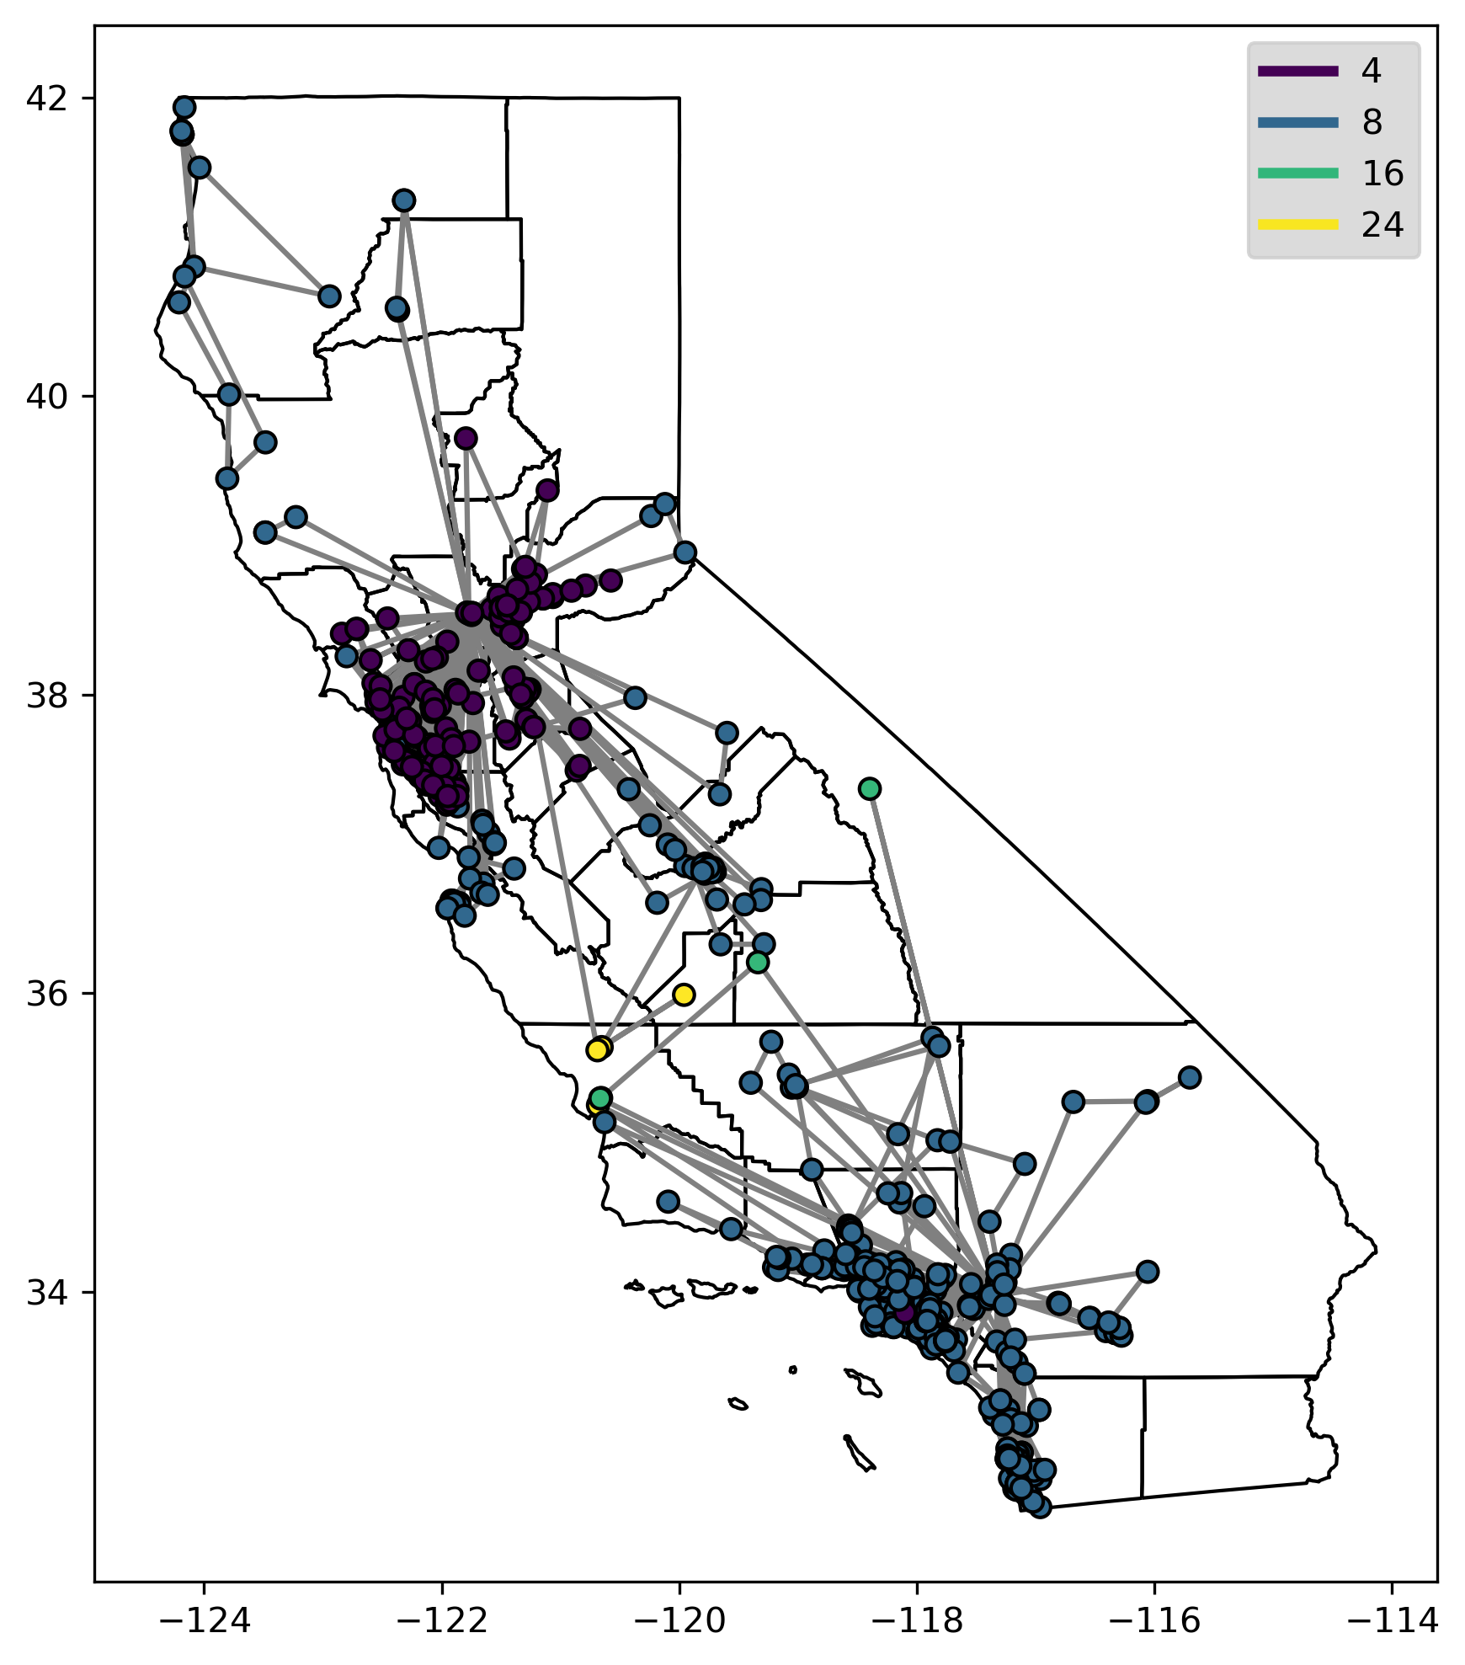
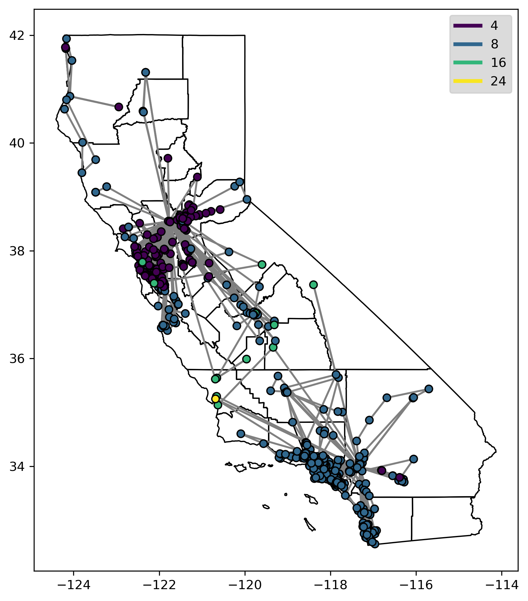
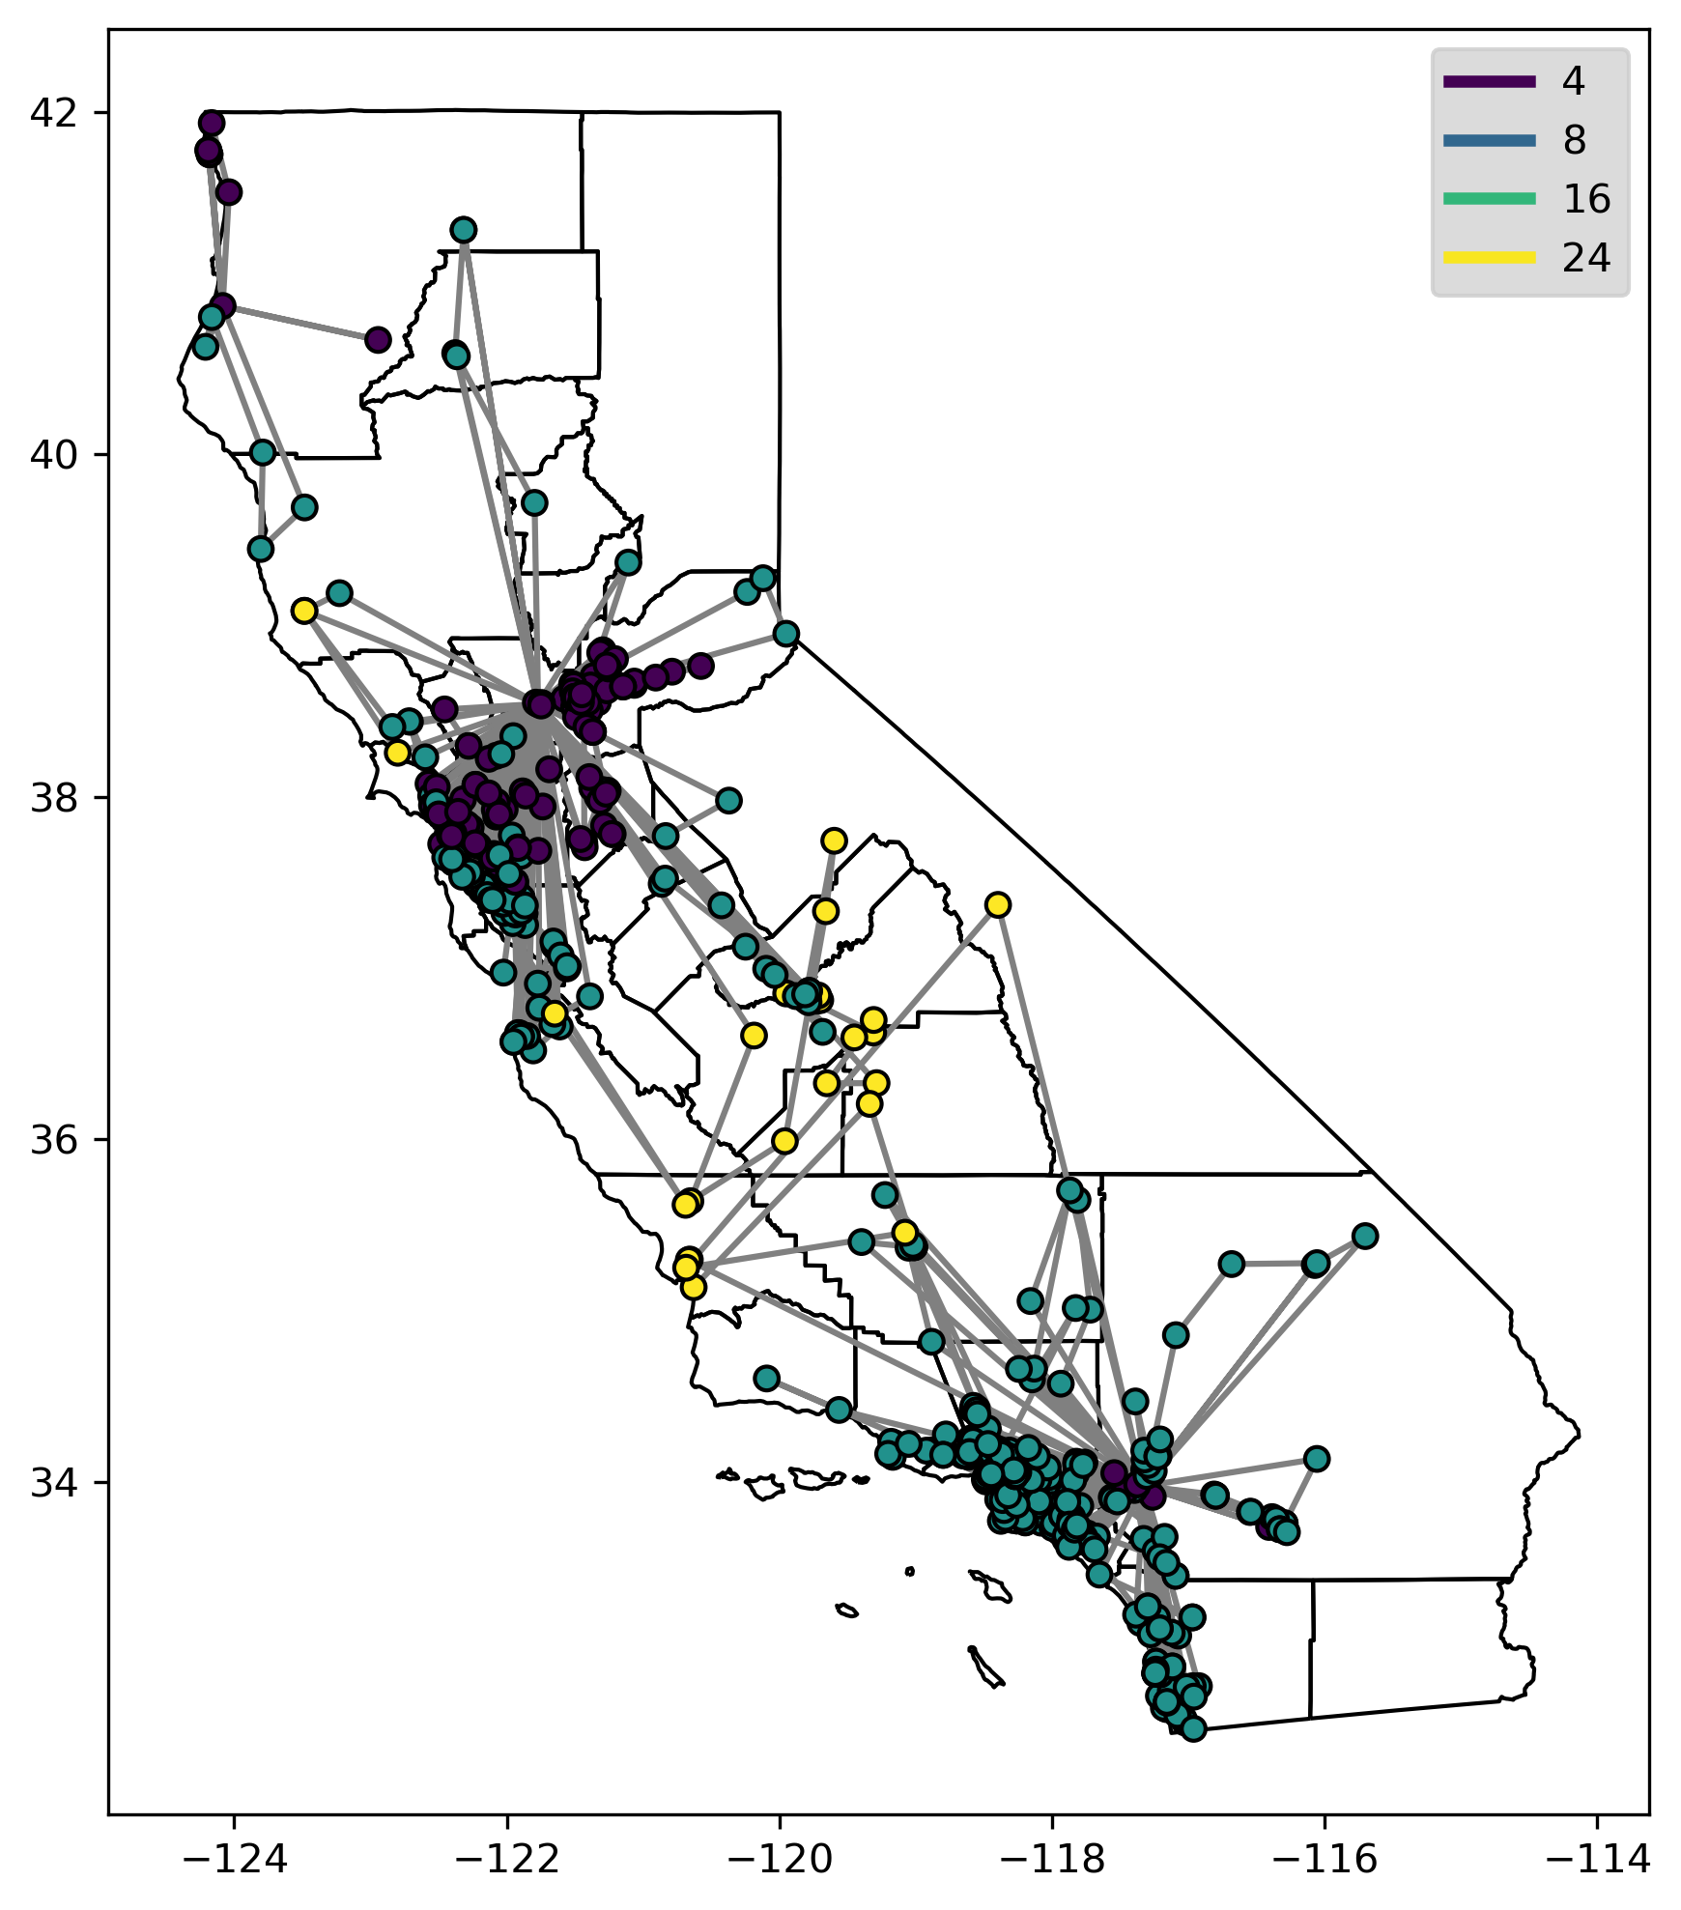
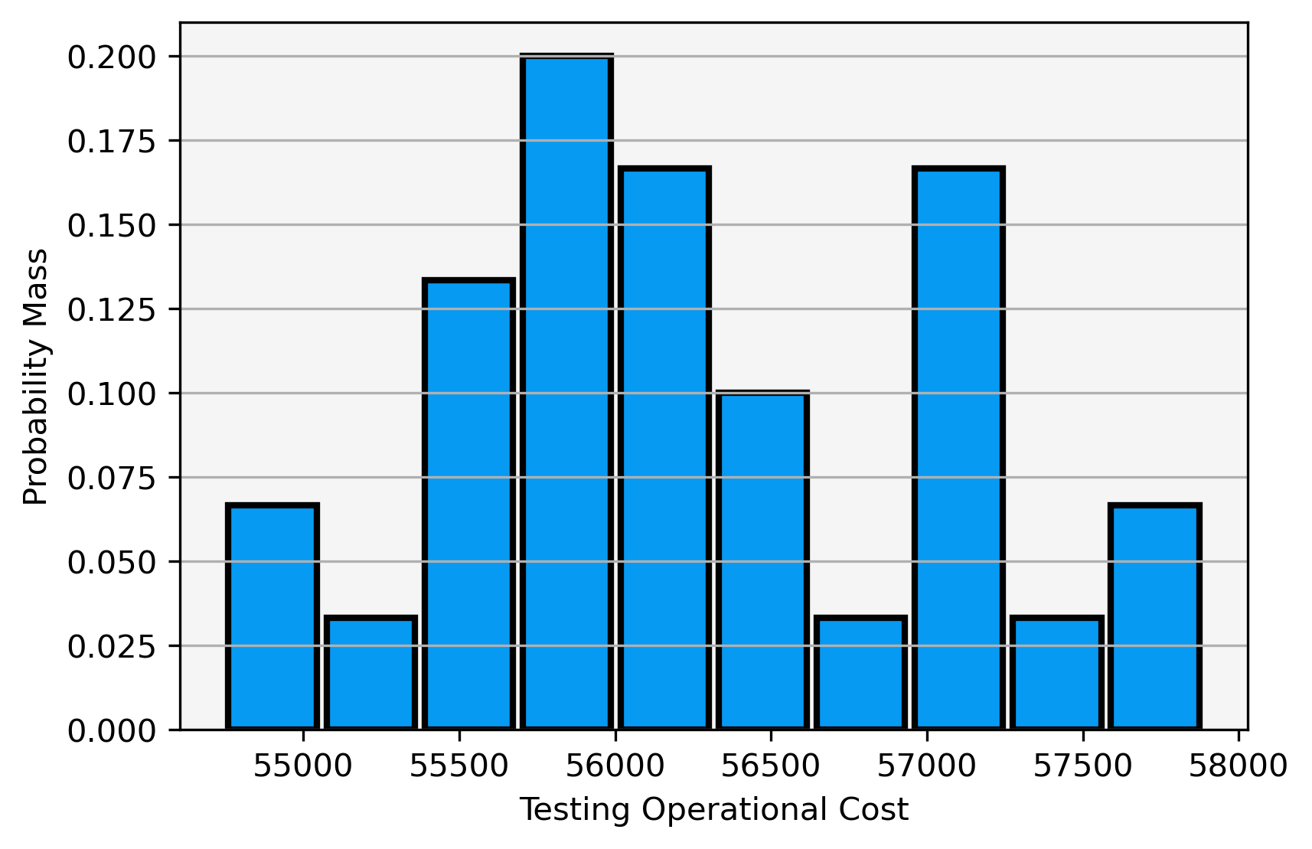
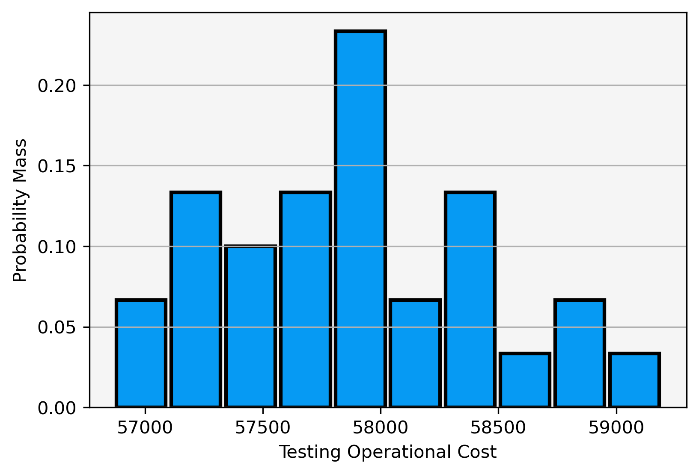
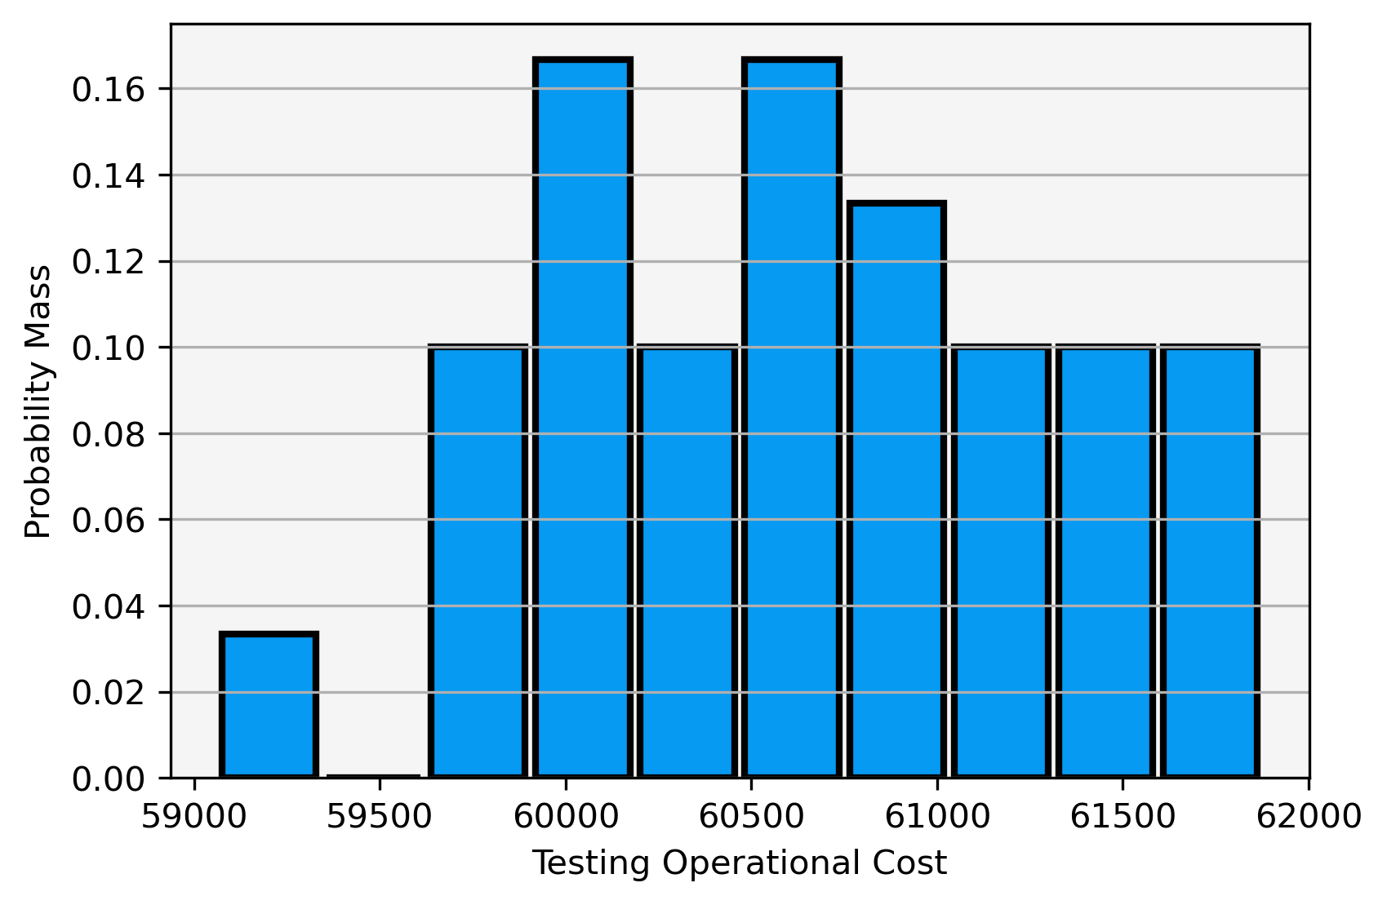
Routing Economics
Ioniq Testing - Personnel and Operations
50th Percentile Routing
75th Percentile Routing
99th Percentile Routing

Slide 11
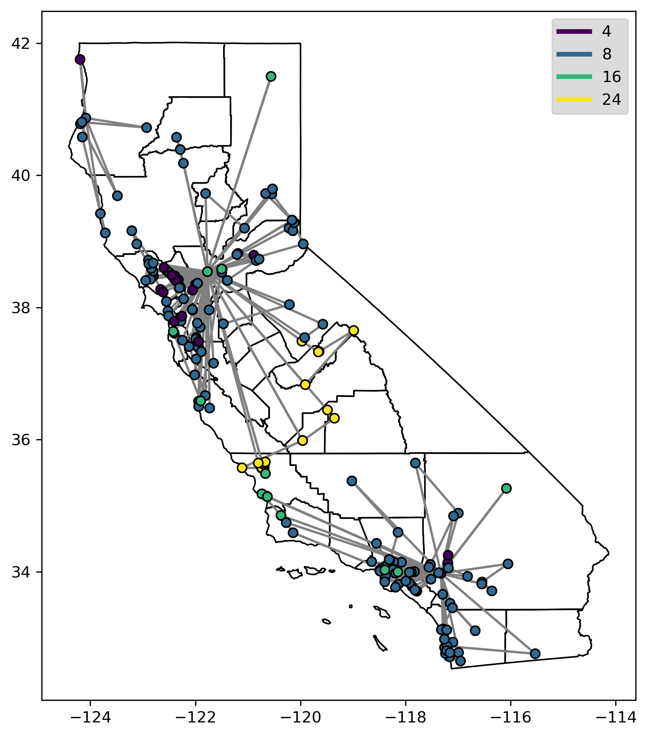
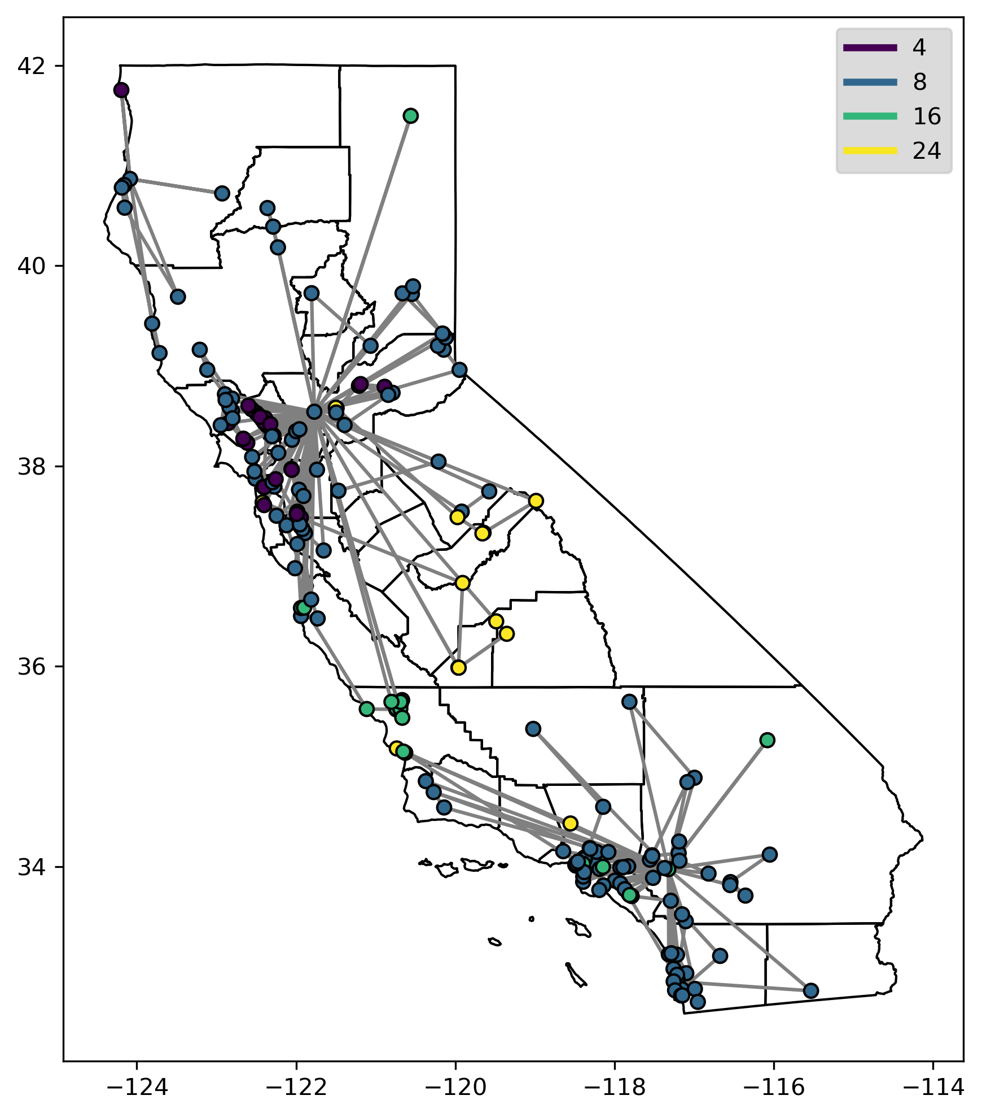
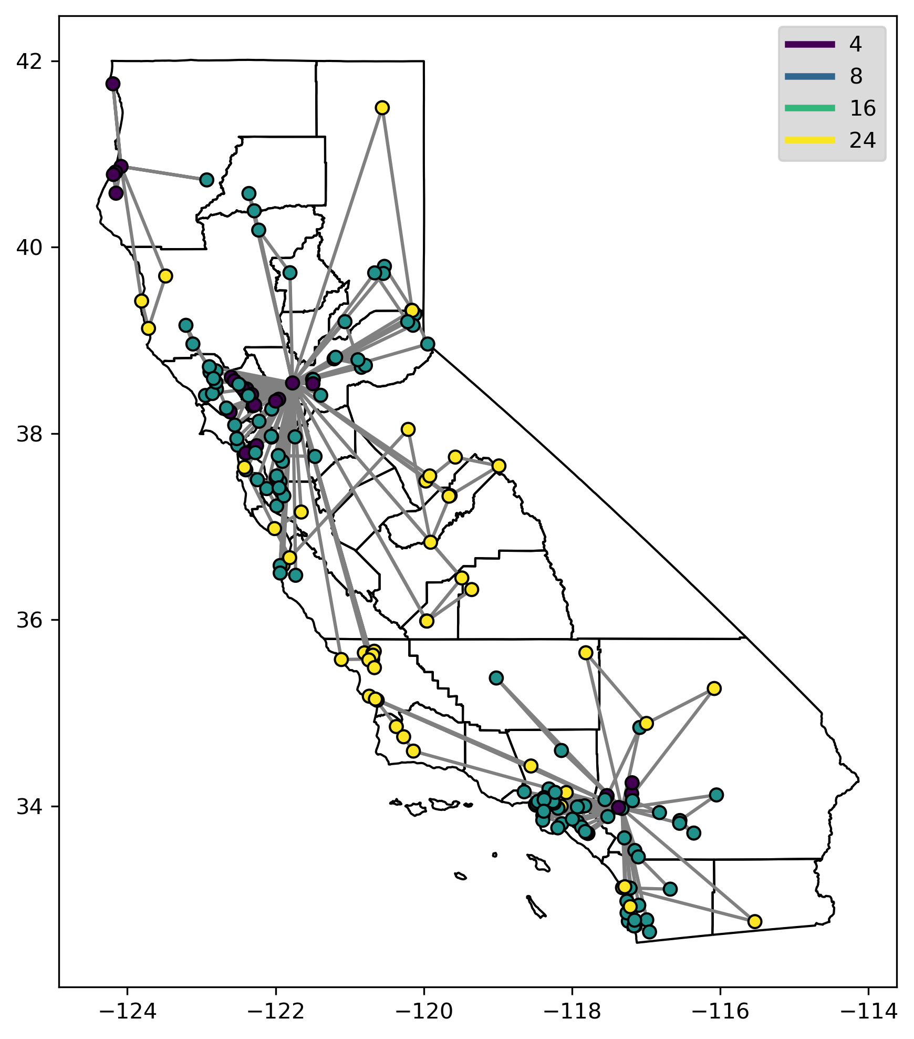
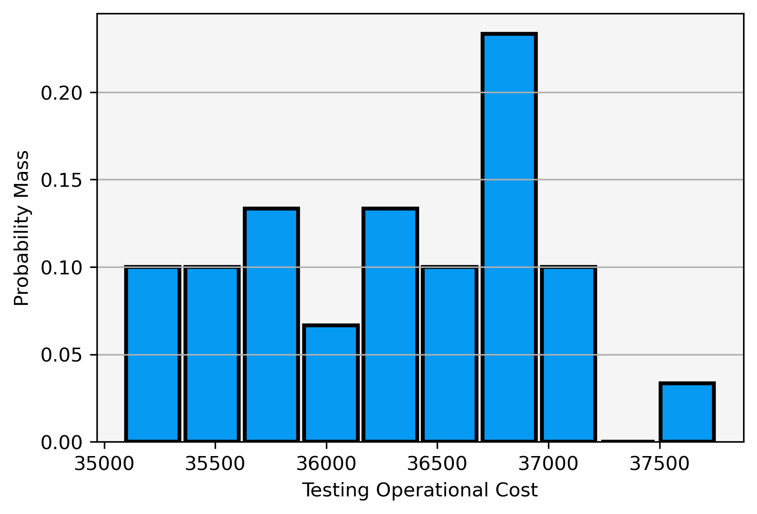
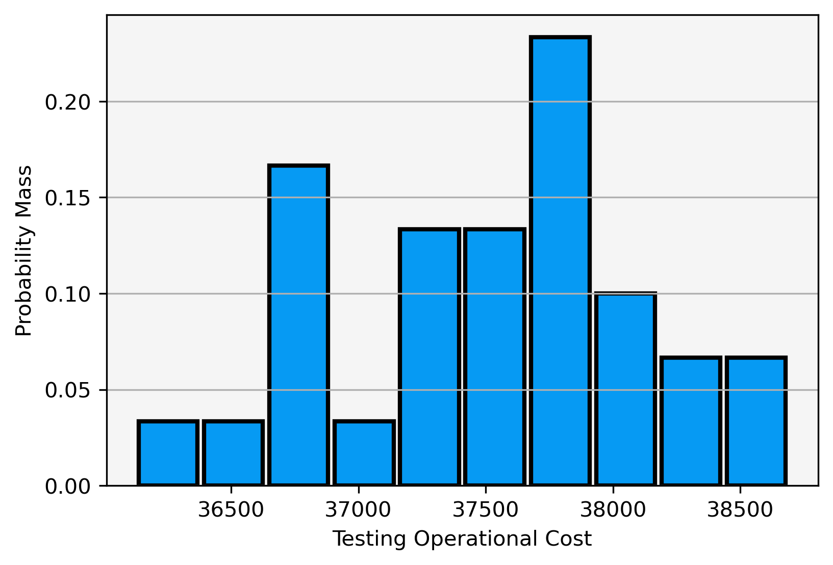
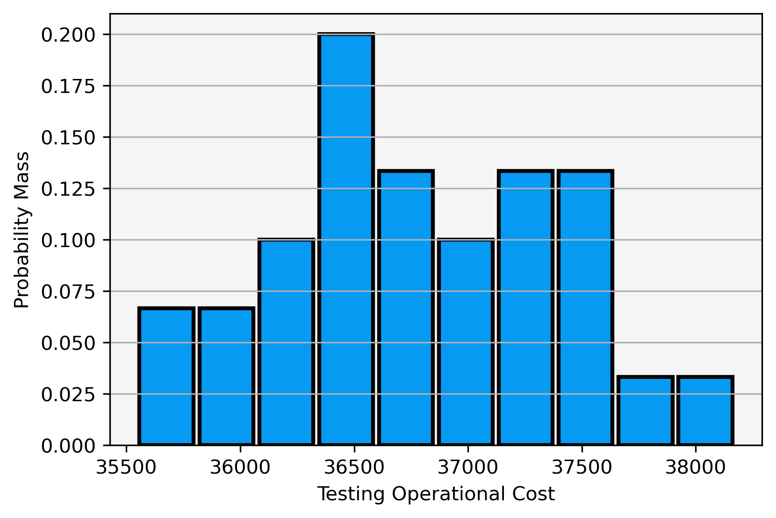
Routing Economics
Model 3 Testing - Personnel and Operations
50th Percentile Routing
75th Percentile Routing
99th Percentile Routing

Slide 12
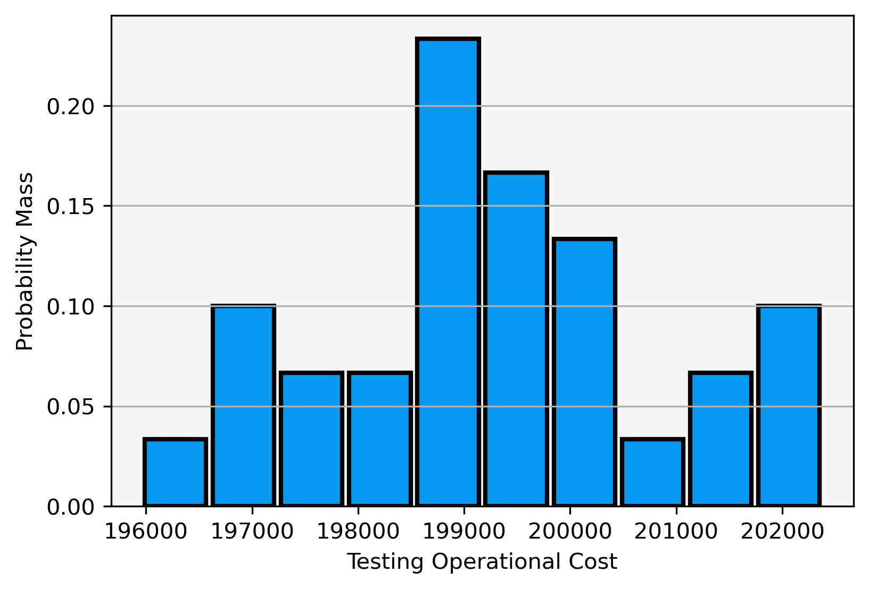
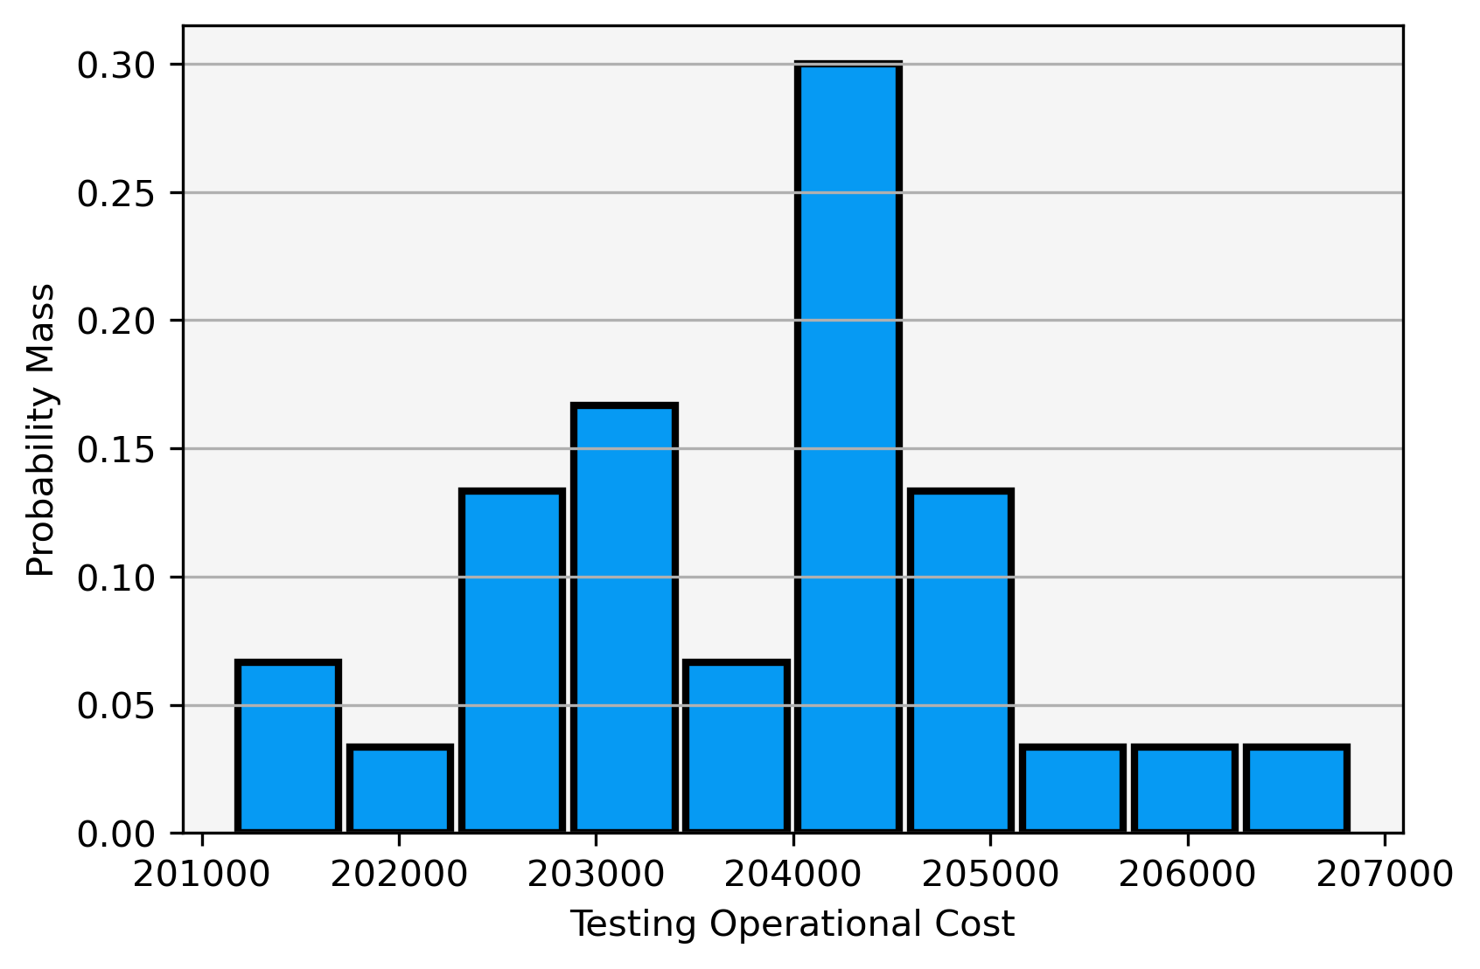
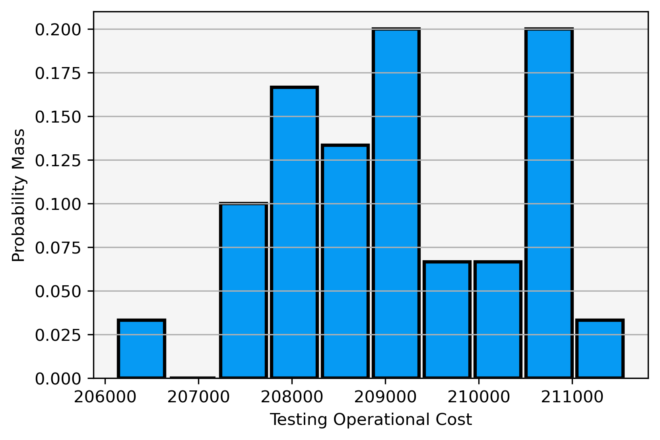
Routing Economics
Project Operational Costs
50th Percentile Routing
Expected Project Operational Cost:
$199,291 pm $1,594
75th Percentile Routing
Expected Project Operational Cost:
$203,843 pm $1,253
99th Percentile Routing
Expected Project Operational Cost:
$209,145 pm $1,308

Slide 13
Routing Economics
Takeaways
Ignoring inflation, testing likely to cost in 300,000 range (Vehicular, Operational, Personnel)
Probably an understatement as this assumes that optimal routes can largely be followed and does not account for complications such as widespread route failure
Modeling can be done for this if required
Value of UC Riverside / Humboltd depots are huge
Selecting chargers (resamplig) closer to depots will reduce project cost
More testing will lead to better informed scheduling
Future steps:
Model improvement
Costs refinement

Slide 14

Q & A

